Slide 1

Meeting with the monitoring committee
3rd year
University of Bordeaux
Doctoral School of Mathematics and Computer sciences
Talence, 20 June 2019

Slide 2

Subject
Supervisor: Marie BEURTON-AIMAR
“Automatic landmarking for 2D biological pictures: image processing with and without deep learning
methods”

Slide 3

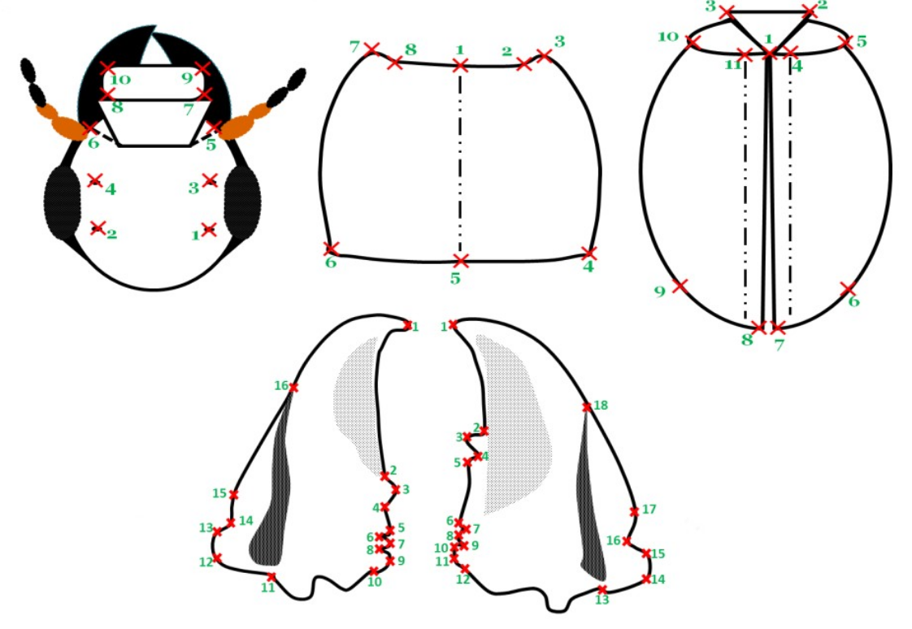
Objective of the thesis

Slide 4

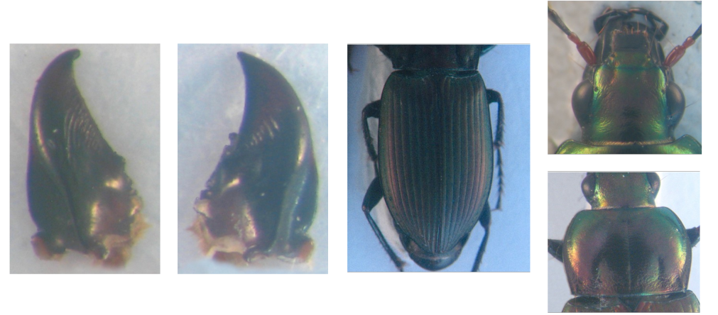
Dataset
Color images (2D) of 293 beetles (3264x2448)
Five images by insect: head, pronotum, elytra, left and right mandible

Slide 5
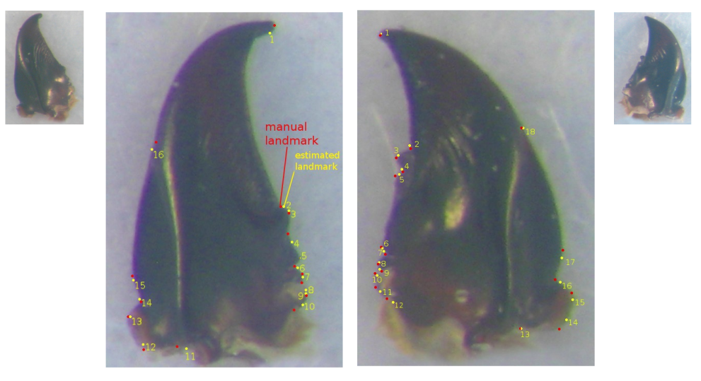
Status of the thesis: the 1st year

Slide 6
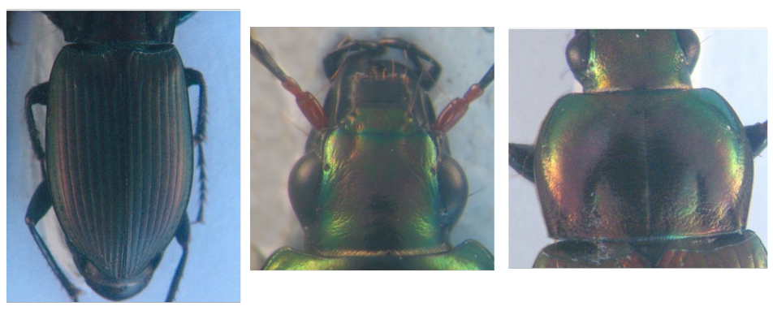
Status of the thesis: the 2nd year
Applying Deep Learning

Slide 7
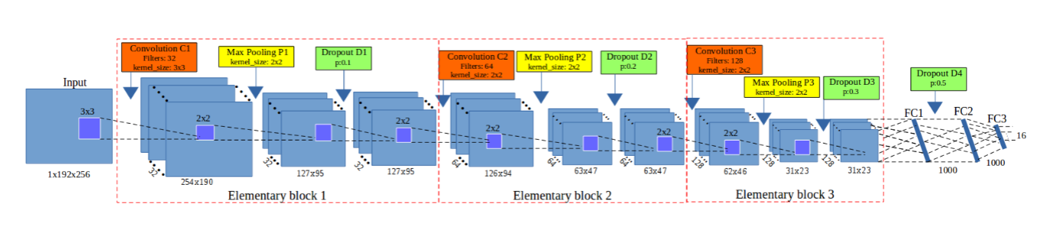
Network architecture

Slide 8
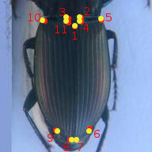
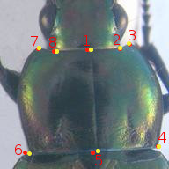
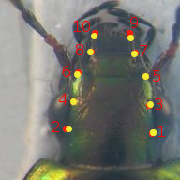
Results in the 2nd year

Slide 9
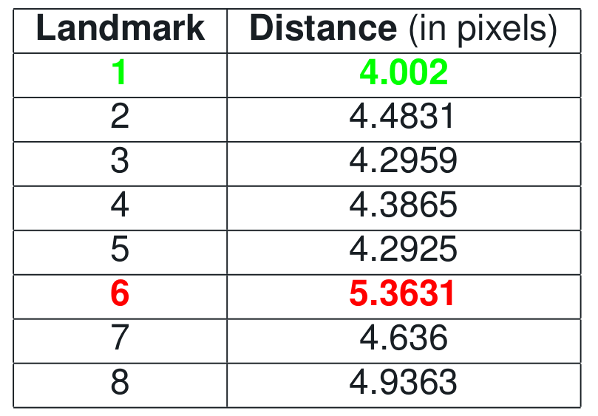
Results in the 2nd year

Slide 10
The 3rd year
Continue the works to improve the results
Finish the required training lectures (100 hours)

Slide 11
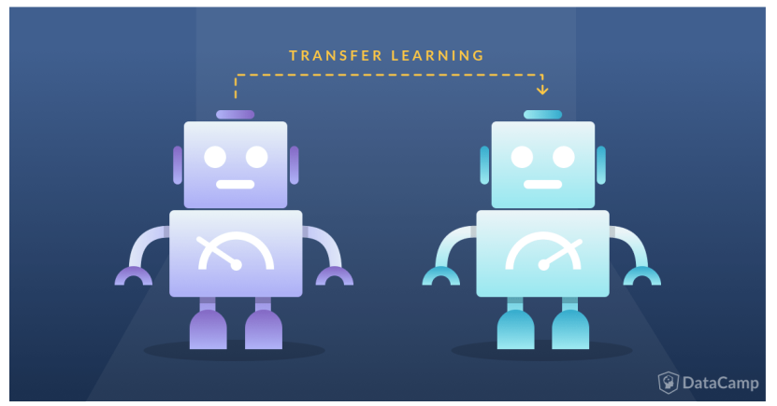
Improving the results

Slide 12
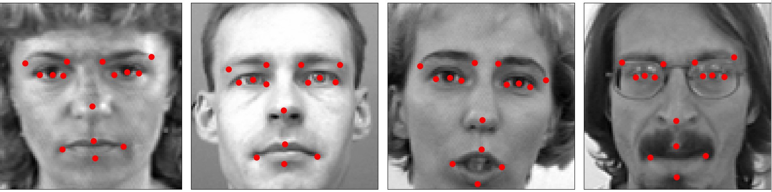
Improving the results
- Continue to use the proposed model
- Pre-train the model on a facial key points dataset. Then, transfer the parameter values to fine-tune on our images.

Slide 13
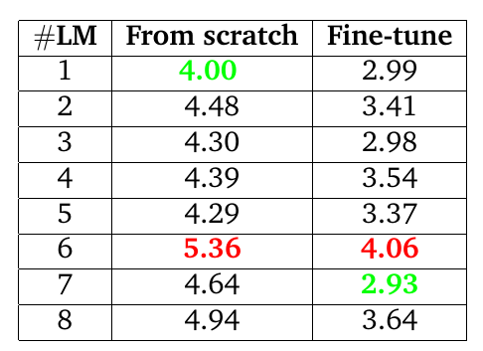
Improving the results
The average distance of each landmark on all pronotum images

Slide 14
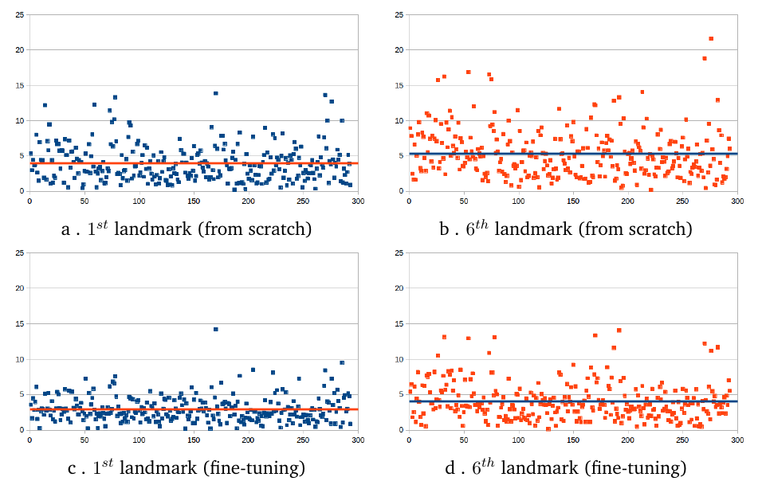
Improving the results
The distribution of the distances
The results have been submitted to Pattern Recognition Journal (under reviewing).

Slide 15
I have done
Research:
  Tried to fine-tune other architectures, but the results were not improved.
  Turned to Reinforcement learning to automatically design architecture, but it was still not succeed.
Academic works:
  Taught several lectures at university
  Applied for a teaching position.

Slide 16
Teaching lectures
5CEF6T0M - TD Gestion des données
5CEG4TFM - TD Systèmes d'information de gestion
TD - Programmation Orientée Objet
Deep learning (Master Bio-Informatique)
Co-supervise: Project programming, Internship

Slide 17
Training courses attended
Francais Langue Étrangère (40 heures)
Anglais niveau intermédiaire (25 heures)

Slide 18
Thank you

